Slide 1
Sport for Development
Using Sport for Social Change
Dr Emma Sherry
Swinburne University

Slide 2
Social Inclusion
Social inclusion is acknowledged as a fundamental step in improving disadvantaged people’s social situations, and sport is argued to be a viable medium for promoting social inclusion.
An individual is socially excluded if:
(a) He or she is geographically resident in a society, but
(b) For reasons beyond his or her control, he or she cannot participate in the normal activities of citizens in that society, and
(c) He or she would like to so participate. (Barry, 2002, pp. 14–15)
Social exclusion can manifest itself in many different ways including unequal access to educational, occupational, and political opportunity PLUS access to basic material considerations (a home, ability to purchase food, transport)

Slide 3
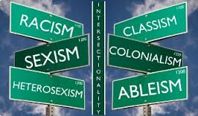
Intersectionality
The interconnected nature of social categorizations such as race, class, and gender as they apply to a given individual or group, regarded as creating overlapping and interdependent systems of discrimination or disadvantage.
In simple terms, a person is not one single “thing”, and the most socially excluded suffer from multiple sources of disadvantage
through an awareness of intersectionality, we can better acknowledge and ground the differences among us

Slide 4
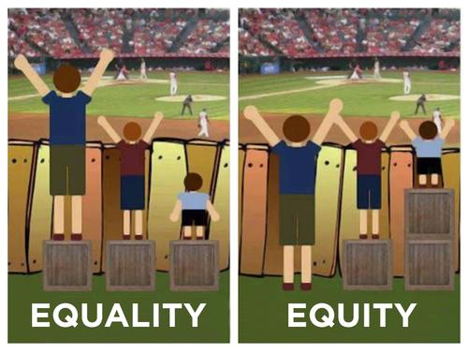
Equality or Equity?
Notes:
I’m assuming everyone in the room has seen this but its still a good one

Slide 5
Marginalised vs minority

Slide 6
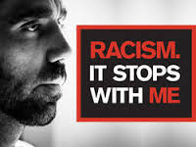
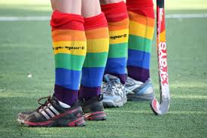
Human Rights Commission - campaigns
Racism it stops with me
Fair go, sport!

Slide 7
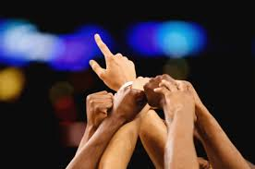
Diversity and inclusion a strategic imperative
Diversity and inclusion whole-of-organisation approach
At risk and marginalised communities

Slide 8
Sport FOR development
Using sport as a tool for non-sport outcomes
Whole-of-government approach
ensuring that the needs of culturally and linguistically diverse communities are conveyed to the relevant bodies and that Government is kept abreast of community concerns

Slide 9
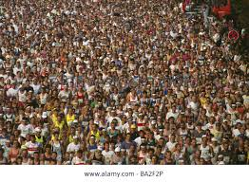
Who are our participants?
Sport participation vs sport consumers vs sport members
Implications for traditional sport structures

Slide 10
Innovation
VicHealth Innovation Challenge
Less than a third of Australians get enough physical activity every day. While many of us play traditional club sport to keep active, it’s not the answer for everybody. Some people are put off by inflexible schedules, cliquey cultures, high costs and limited opportunities for beginners and veterans.
Recent trends show that participation is shifting. People are gravitating towards individual and fitness-based sports. Lifestyle, adventure and alternative sports are on the increase. People are choosing to participate in activities such as jogging, aerobics, cycling, group fitness training, fun runs and even military obstacle courses!
More and more people are looking for flexible, social and less structured ways to get active. So, let's give it to them

Slide 11
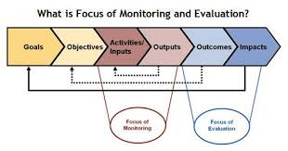
Monitoring and Evaluation

Slide 12
Looking ahead…
Enhanced social inclusion is dependent on:
Individual club or organisation capacity of key leaders
Proximity of the champion of change
History of club development being celebrated
Program design that integrates people rather than segregates within a club
Agency alignment of language, intent and evaluation of programs in the general space of social inclusion

Slide 13
Thank You! Email: esherry@swin.edu.au

