Slide 1
National Indigenous Business Summer School
13-20 January 2018

Slide 2
Monday schedule
Introduction to the Faculty of Business & Economics and Q&A
Morning Tea – tour of building
Associate Prof. Emma Sherry, Swinburne University – Engagement in Sport for Social Impact
Thara Brown, Korin Gamadji Institute, Richmond Football Club
Lunch
Foundation for Young Australians – Teamwork skills, Crack the case workshop
Dinner – Betty’s Burgers

Slide 3
Introduction to the Faculty of Business & Economics
Welcome from the Dean, Professor Paul Kofman
Introduction to the Faculty of Business & Economics and Q&A
  What is the Bachelor of Commerce – Josephine Pope
  Accounting – Associate Professor Albi Brooks
  Management – Professor Bill Harley
  Marketing – Dr Michal Carrington
  Economics – Professor Jeff Borland
  Finance – Dr Carsten Murawski

Slide 4
Bachelor of Commerce at Melbourne
Faculty of
Business and Economics
Josephine Pope
Faculty of Business and Economics

Slide 5

Why Choose Commerce?
A Distinguished Degree
Learn from award-winning academics who are leaders in their fields
Explore Commerce disciplines before you make a choice
Foundation of business skills and specialist knowledge
More than a degree
Unique student experience and opportunities
Excellent facilities and student services
Global alumni network from 54 countries
Well-rounded graduates
#7 in the world for the employability of our graduates (QS 2018)
QS World Rankings 2018
#14
Accounting and Finance
#22
Business and Management Studies
#25
Economics and Econometrics

Slide 6
Course Structure
24 subjects - 8 per year
COMPULSORY SUBJECTS 7 subjects to cover Commerce fundamentals | CORE SUBJECTS 11 - 13 subjects to deepen your Commerce knowledge | BREADTH SUBJECTS 4 - 6 subjects from other disciplines

Slide 7



Single or Double Major
First Major | Second Major
Business | None
Actuarial Studies | None
Accounting | Finance, Economics, Management or Marketing
Economics | Accounting, Finance, Management or Marketing
Finance | Accounting, Economics, Management or Marketing
Management | Accounting, Economics, Finance or Marketing
Marketing | Accounting, Economics, Finance or Management

Slide 8
Sample Study Plan: Accounting and Marketing
Introductory
Microeconomics
Quantitative Methods 1
Accounting Reports & Analysis
Principles of Marketing
1st Year
Introductory Macroeconomics
Principles of Finance
Introductory Financial Accounting
Principles of Business Law
Organisational Behaviour
Cost Management
Consumer Behaviour
Corporate Law
2nd Year
Quantitative Methods 2
Intermediate Financial Accounting
Accounting Information:
Risk & Controls
Entrepreneurial Marketing
Enterprise Performance Management
Financial Accounting Theory
Retail Management
Media Psychology
3rd Year
Auditing and Assurance Services
Neuromarketing
Business Judgement
Taxation Law 1
Compulsory Subjects
Accounting Subjects
Marketing Subjects
Breadth Subjects

Slide 9

Enrichment and Employability Opportunities
Experiential Learning
Management Consulting
Street Finance
Clubs & Societies
Commerce Students’ Society
Melbourne Microfinance Initiative
Banking on Women
Global study opportunities
Exchange & Study Abroad
International Study Programs
Global Management Consulting
Case Competition and Entrepreneurship
Unimelb StartUp Program
BCom and International Case Competitions
Career Preparation
Career Mentoring Program
Skills Workshops
Internships
Future Leaders Forum

Slide 10
National Indigenous Business Summer School
January 2018
Accounting within a BCom Degree

Slide 11
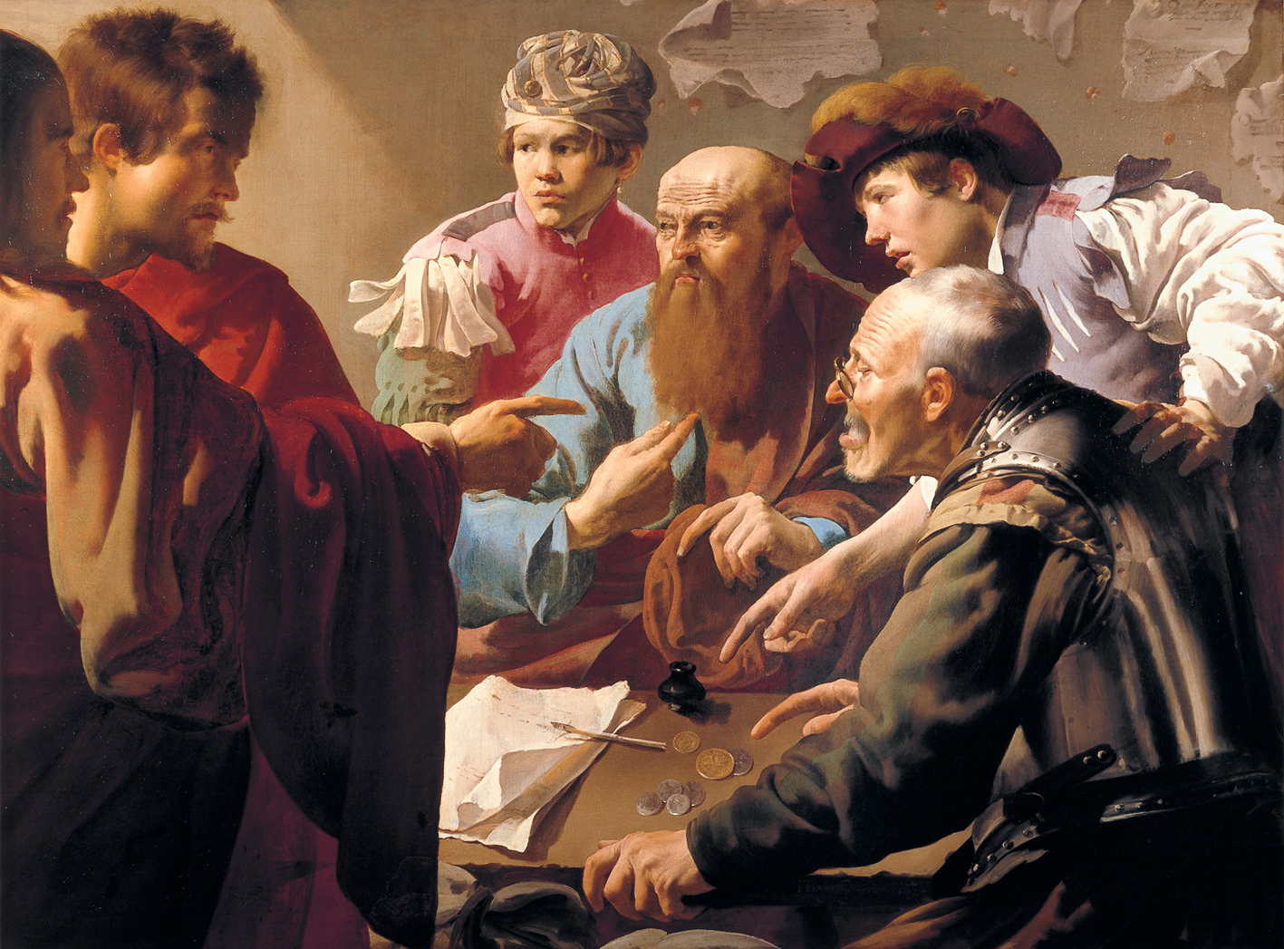


Slide 12
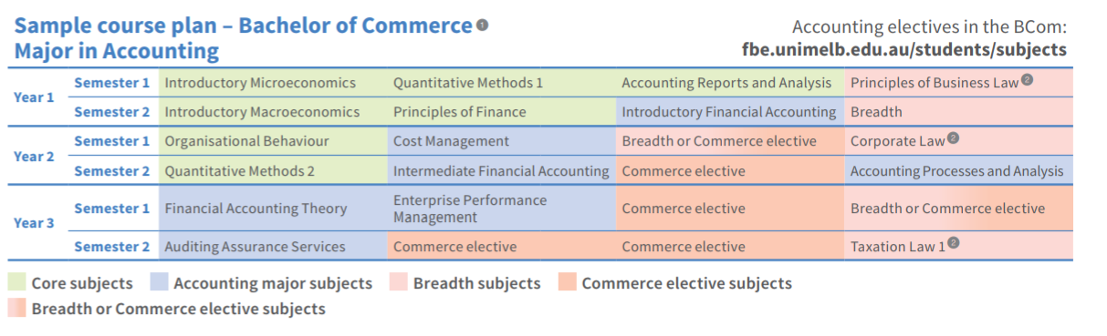
Accounting in a Commerce/Business Degree

Slide 13
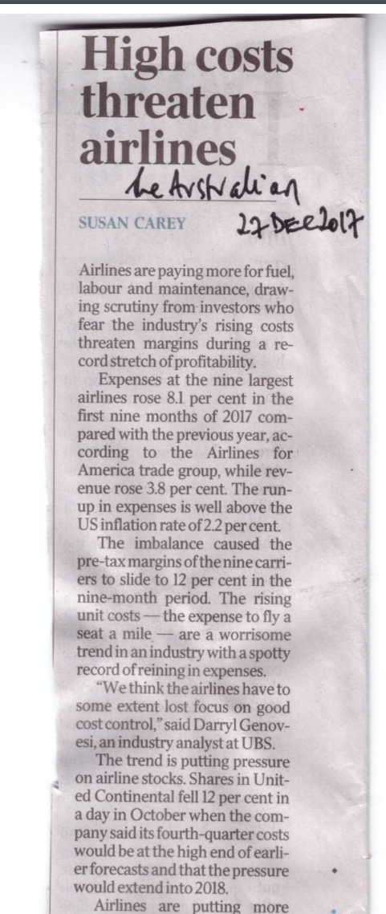

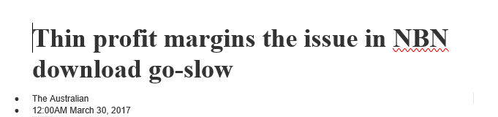
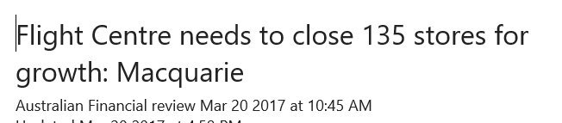
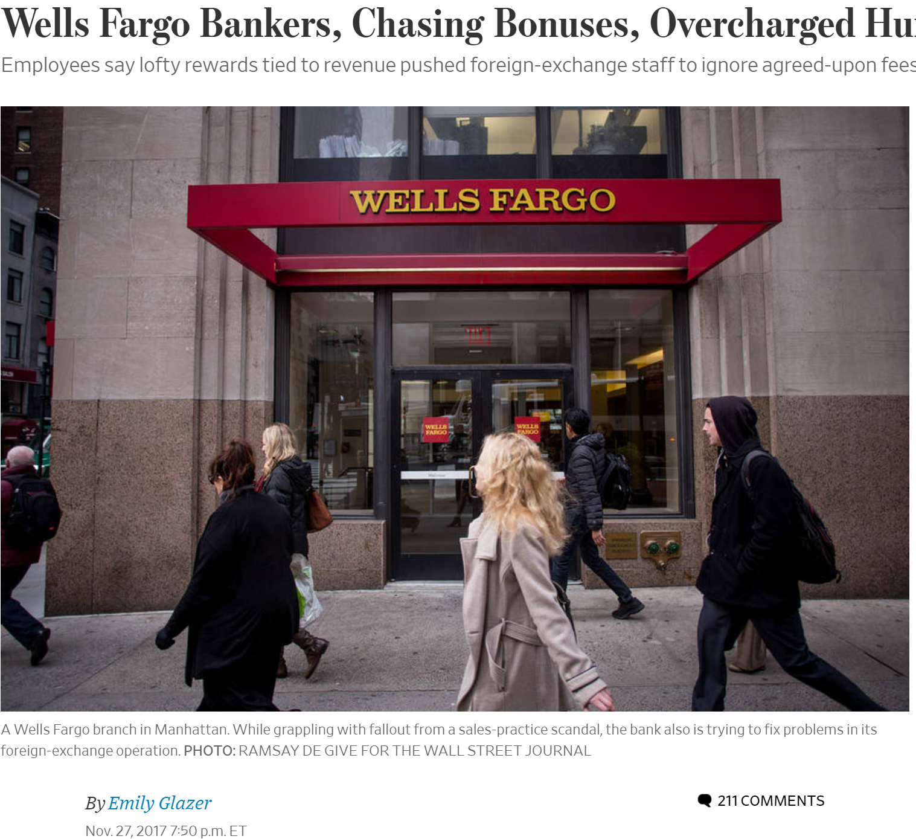
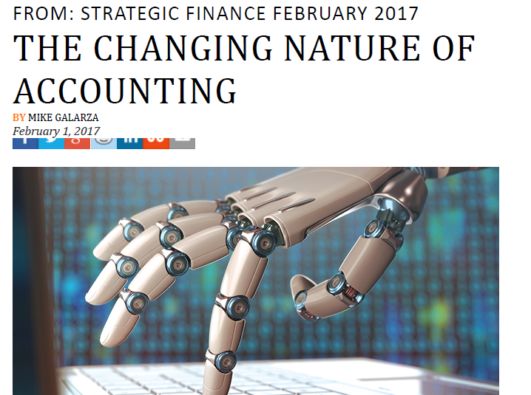
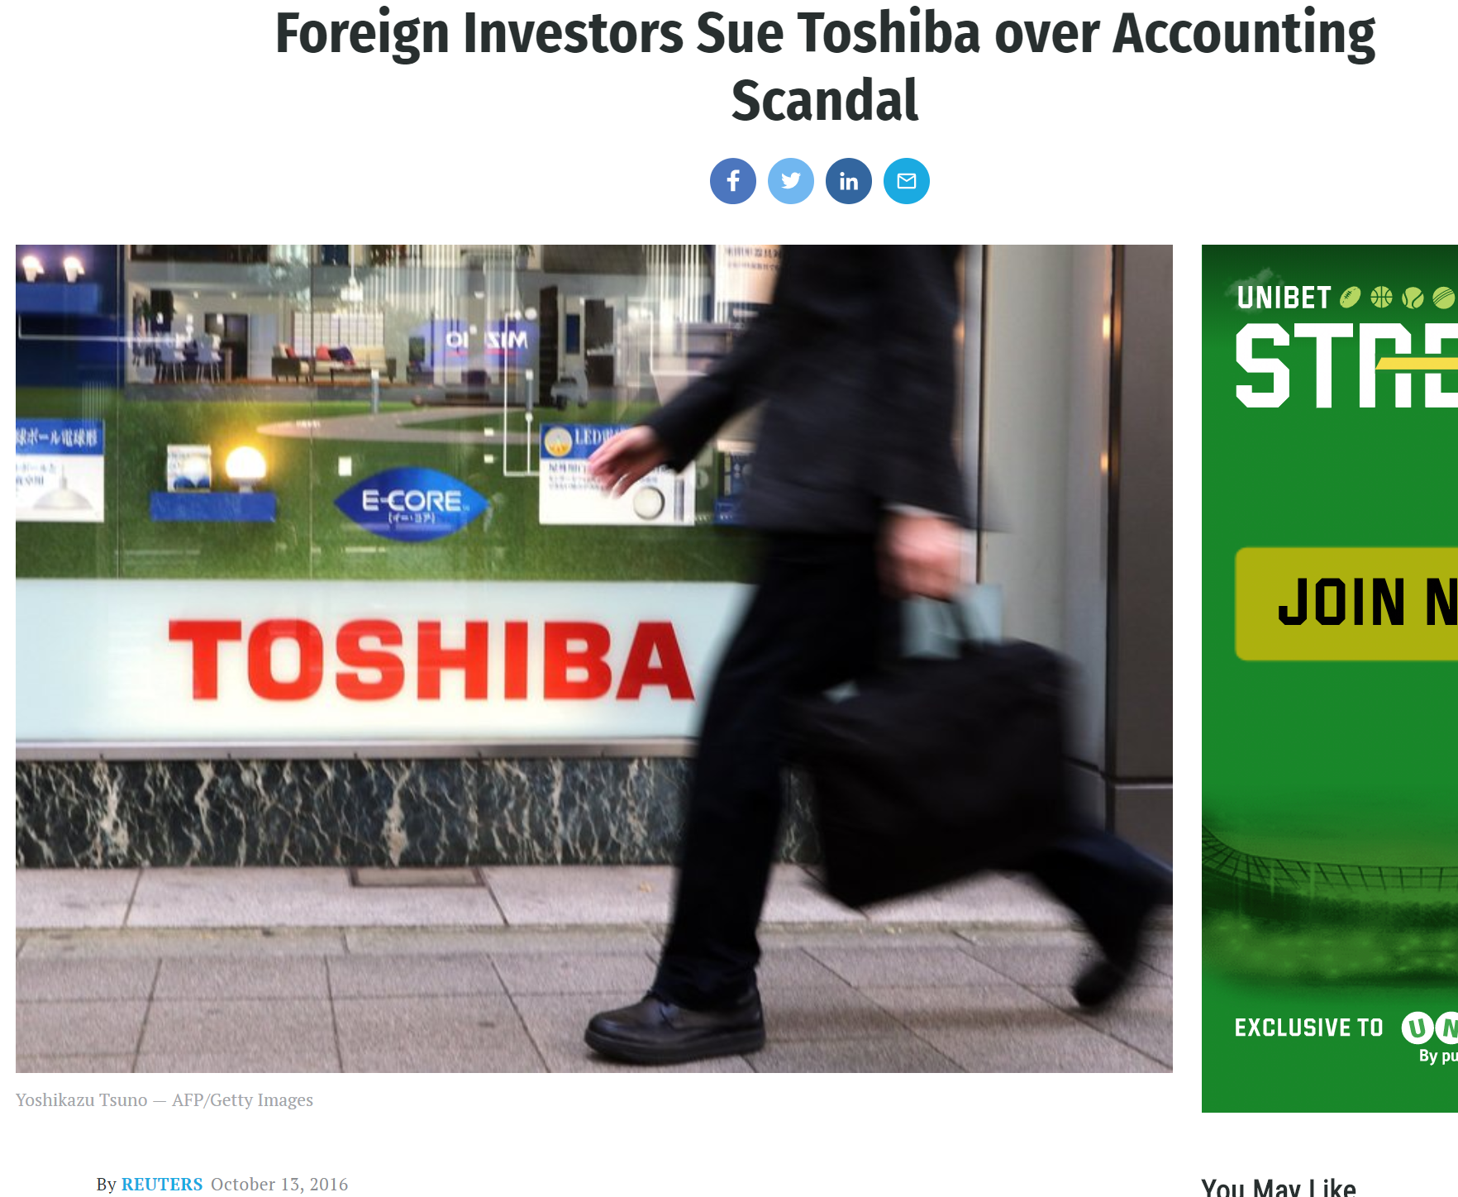
Wall Street Journal
Fortune Magazine

Slide 14
Some examples of what might you do an accounting degree?
Accounting and consulting services in large accounting/consulting firm
Preparer of financial reports in industry
Support management through production of relevant accounting-based information in industry
Providing accounting services in government departments
Auditor for large accounting firm
An accounting teacher or academic
Data analyst
Forensic accountant
Tax accountant
An accountant to small businesses

Slide 15

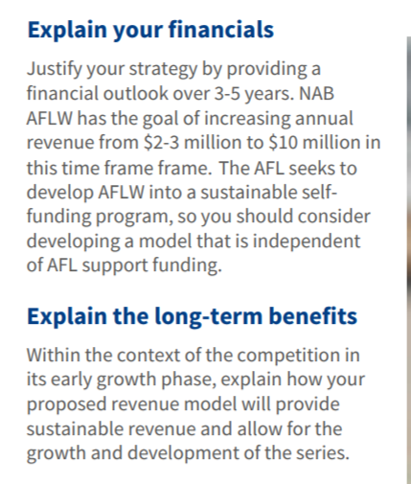

The case…..where’s some accounting??

Slide 16
Contact details:
Email: albieb@unimelb.edu.au

Slide 17

Management
Bill Harley
Department of Management and Marketing
bharley@unimelb.edu.au
www.fbe.unimelb.edu.au

Slide 18

What is Management?
The world is made up of organisations, eg. businesses, government, NGOs, universities, etc.
To be successful, an organisation has to have a strategy – “what do we want to achieve and what do we need to do to achieve it?”
To pursue a strategy, organisations have to allocate resources – money, equipment, etc.
And the people who make up the organisation have to use those resources to do all the things that need to be done for the organisation to achieve its strategy
Management is about making sure all these things get done
www.fbe.unimelb.edu.au

Slide 19
What do management students learn?
Three examples:
A small but successful Australian start-up is ready to expand internationally. What do its owners need to do to develop an internationalisation strategy?
An organisation wants to improve the quality and timeliness of services it provides. How can systems be developed and staff trained to do this?
Staff in an organisation seem unmotivated and miserable. What is causing this problem and how can their working conditions be changed to fix it?
www.fbe.unimelb.edu.au

Slide 20
What subjects might you do?
Some examples:
  Organisational behaviour: understanding human behaviour in organisations
  International business: understanding how organisations can compete in international markets
  Human resource management: understanding how to manage people for good performance
  Strategic management: understanding how organisations can develop and implement strategy to be competitive
  Negotiation: how to make deals
www.fbe.unimelb.edu.au

Slide 21
How do we teach management in universities?
Theory helps students understand why and how organisations work (or don’t work).
Research evidence allows students to test theories and develop knowledge
Experiential learning helps students develop a practical understanding of how management theory, informed by evidence, can be put into practice
www.fbe.unimelb.edu.au

Slide 22

Possibilities in…
…Marketing
Dr Michal Carrington
Department of Management & Marketing
Faculty of Business and Economics
www.bcom.unimelb.edu.au

Slide 23




Possibilities in…
…Marketing
Dr Michal Carrington
Department of Management & Marketing
Faculty of Business and Economics
TEACH…
RESEARCH…
…MANAGERIAL ETHICS
…CONSUMPTION ETHICS
…CONSUMER WELL-BEING
…RETAIL

Slide 24


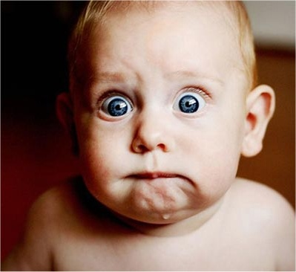
















Possibilities in…
…Marketing

Slide 25
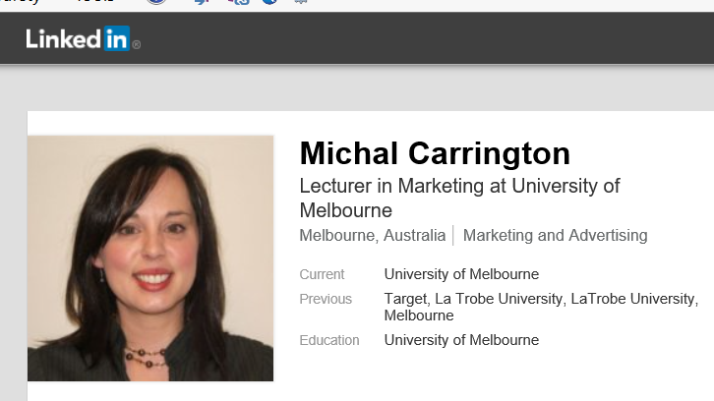

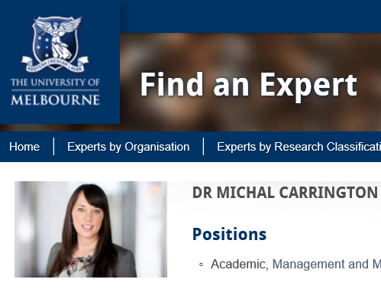

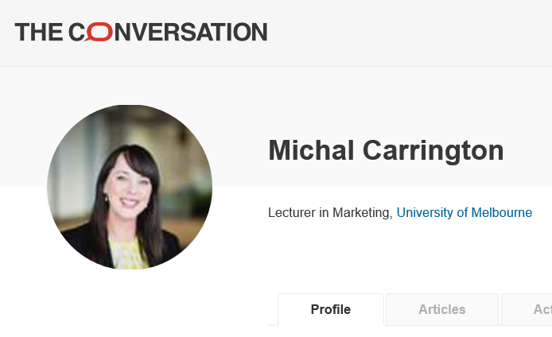
Projecting Identities…
It is an innate human desire to project ourselves as possessing particular characteristics…
…to be who our audience wants us to be…
…and to re-launch who we are…

Slide 26


Symbolic Meanings…
We imbibe objects with symbolic meaning over and above functional attributes…
Is a shoe just a shoe?
FASTER
Social Class
Transitions
Nostalgia

Slide 27

Marketing…
Organisations harness this human capacity to transfer identity and meaning to objects, and to present these transformed objects to others…..
Marketing

Slide 28

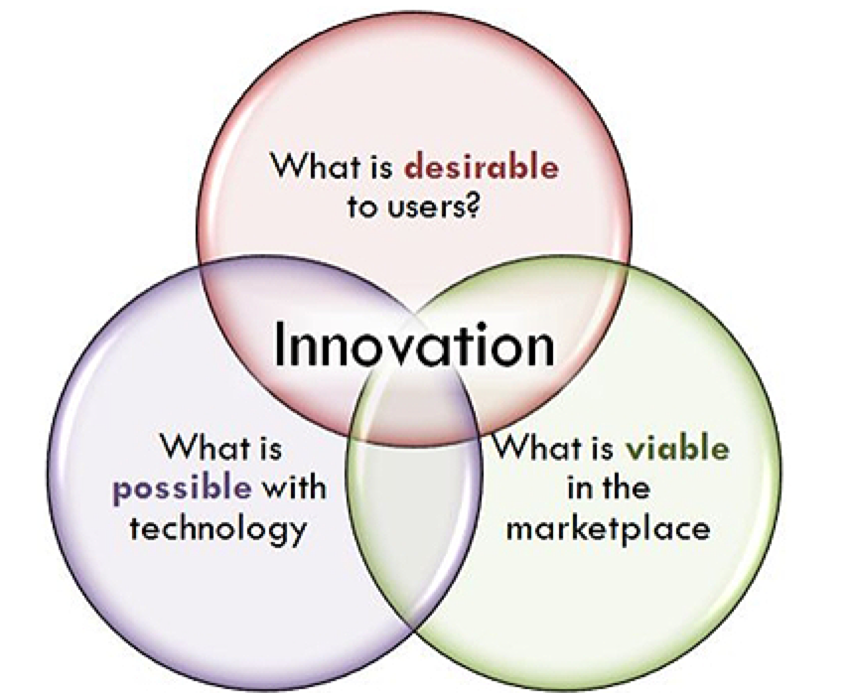

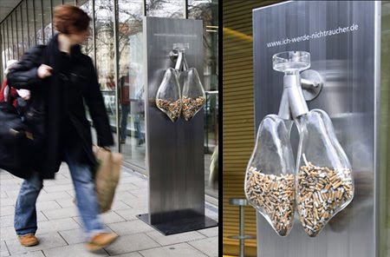



Possibilities in…
…Marketing
MARKETING
Research & Innovation
Brand Mngmt
Comms: Advertising & PR
Retail Mngmt & Buying
Social Marketing

Slide 29
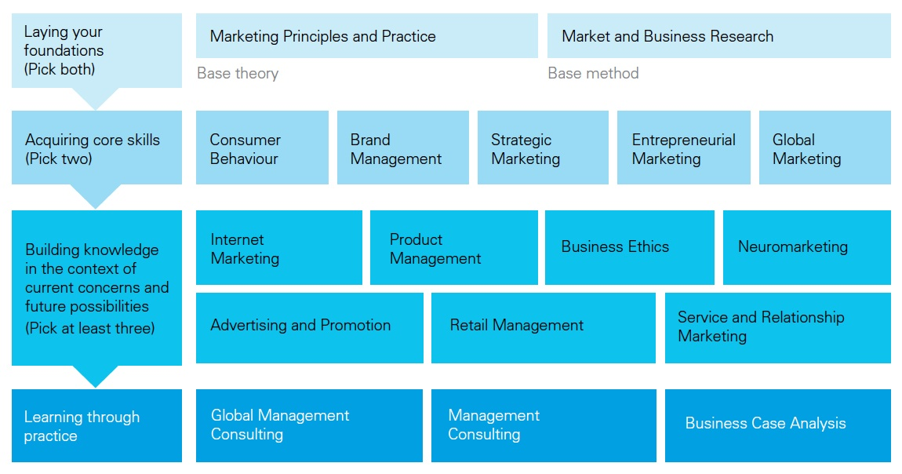
Possibilities in…
…Marketing
So you want to manage big brands…

Slide 30

Possibilities in…
…Marketing
Real world experience
MGMT30012 Management Consulting – working in teams with great companies in Melbourne
MGMT30017 Global Management Consulting – working in teams across the globe, including Hong Kong, Chile, Singapore,
China, Thailand, Malaysia, and India

Slide 31
Possibilities in…
…Marketing
Dr Michal Carrington michal.carrington@unimelb.edu.au
Department of Management & Marketing
Faculty of Business and Economics
THANK YOU!!!!
www.bcom.unimelb.edu.au

Slide 32
What is economics, and what can you do with it?
Jeff Borland jib@unimelb.edu.au
Presentation to National Indigenous Business Summer School at the University of Melbourne,
January 15 2018

Slide 33
What is economics?
A difficult question to answer!
A possible definition: Distinctive methods of analysis that provide an understanding of economic activity and how society operates
It’s more informative to give examples of questions that economists study.
A preliminary comment:
Economics spans the world of business
Economics is the language of government policy making

Slide 34
Examples of business topics that you learn about in economics
How do markets work?
Prices: Eg., How does a cyclone in Queensland affect the price of bananas?
Quantity produced: Eg., The cycle of entry and exit of mining businesses during the mining boom in Australia in the 2000s
What strategies can a business use to maintain and increase its market power?
How should a business set its prices?
- Eg., Versioning, bundling, discount offers, customer-specific prices
How can a business manage its costs?
Dealing with uncertainty and information asymmetries

Slide 35
Examples of government policy topics that you learn about in economics
How can government manage the rate of inflation and rate of unemployment?
Do we need a policy to address climate change, and what should that policy be?
What role should government have in providing infrastructure and education and health services?
What is the best tax system for collecting government revenue?
What is the optimal level and composition of immigration?
What is needed to increase economic development in the world’s poorest countries?

Slide 36
So where can this lead you?
1] Jobs in government
In Australia – eg., RBA, Treasury, ACCC
International – eg., UN, World Bank
2] Jobs in the private sector
Consulting firms
Banking
Other types of business
3] Jobs in not-for-profit organisations
4] A career as a university academic

Slide 37
A specific example of what you can do with economics
Evaluating whether government policy is working
Examine data on outcomes from government policies to establish whether they are achieving their objectives and/or improving well-being in society
An increasingly important area of economics – Especially with regard to social policies (eg., programs to assist jobseekers and people with disabilities to get back into work; programs to improve learning outcomes for children from disadvantaged backgrounds)
An area that is highly relevant to Indigenous Australians

Slide 38
Two case studies
Evaluation 1: Assignment of babies to Special Care Nursery Treatment in the Northern Territory
Kevin Schnepel and Stefanie Schurer (2017), ‘Early life health interventions and childhood development’, mimeo, University of Sydney.

Slide 39
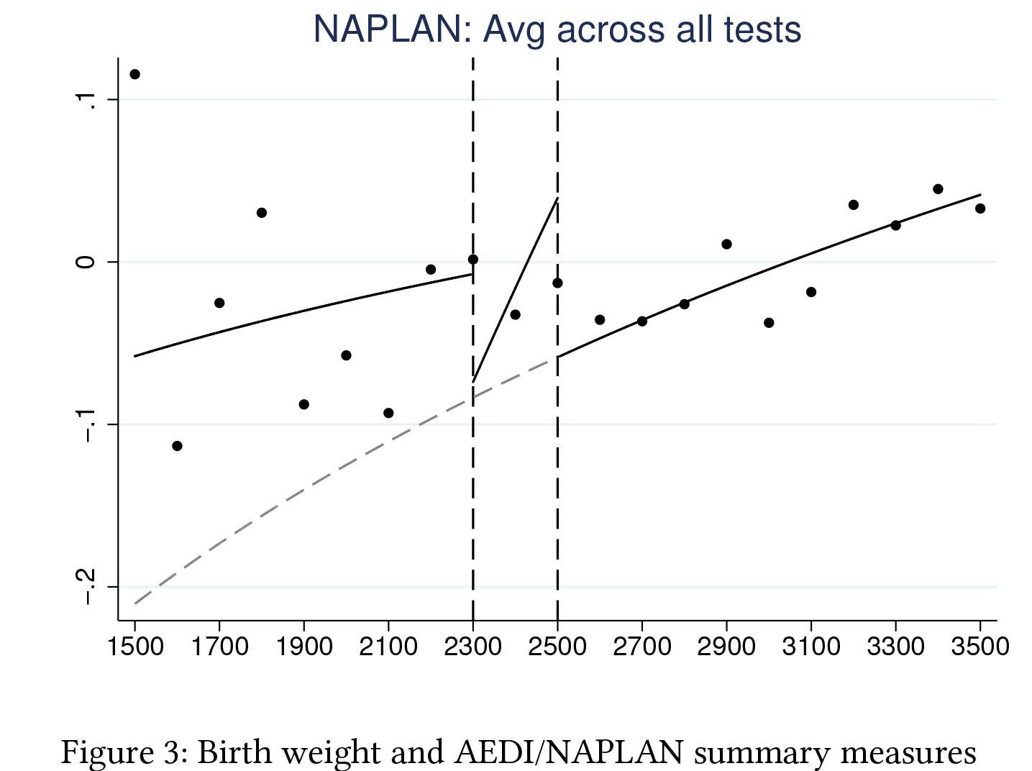

Slide 40
Two case studies
Evaluation 2: The pilot of the cashless debt card at Ceduna and in the East Kimberley region for welfare payment recipients
Commonwealth Department of Social Services (2016), ‘Cashless Debt Card Trial Progress Report’, Canberra.

Slide 41
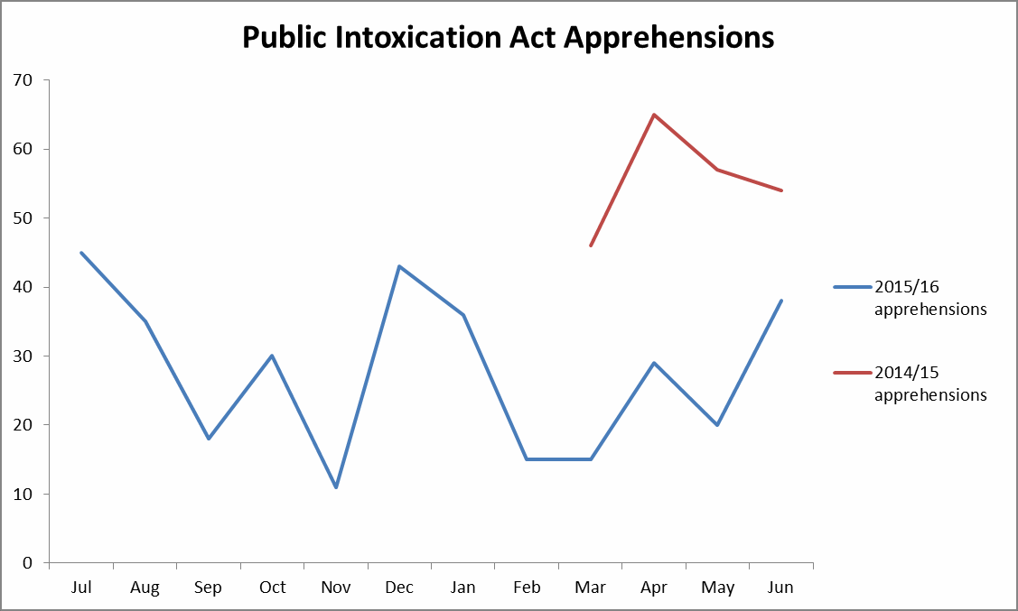
Public Intoxication Act Apprehensions – Ceduna
Key takeaways
The period from March 2016 to June 2016 saw an average 54 per cent fewer apprehensions per month compared to the same period in 2015.
In February 2016, 15 people were apprehended under the Act. In June 2016, this increased to 38 apprehensions.
Despite this, the number of apprehensions since the trial commenced is significantly lower compared to the same period in 2015*.
After a decline in May 2016, the number of apprehensions under the Public Intoxication Act 1984 (SA) has been increasing.
Trial began 15 March 2016
Liquor restrictions began 28 August 2015
Note: Liquor restrictions introduced in Ceduna limit the amount of takeaway alcohol an individual can purchase and records the details of anyone purchasing two or more bottles of spirits. Additionally, takeaway alcohol cannot be sold to anyone living in Oak Valley, Maralinga Tjarutja Lands, Yalata Reserve, Tjuntjunjara, Umoona Community, APY Lands, Ngaanyatjarra Lands and Tjuntjuntjura Lands.
* 2014/15 data is only available for March 2015 to June 2015 to provide a baseline for the trial period.
Source: SA Department for Communities and Social Inclusion

Slide 42
My argument
1] Evaluations of government policies influence the design of future policies
2] At present, government policy is influenced by well-done and poorly-done evaluations
3] We need to increase the amount of well-done evaluations and be able to criticise evaluations that have been poorly done
4] There is an opportunity for Indigenous economists to make a huge contribution to improving the quality of policy evaluation, and to therefore assist in getting better designed policies in Australia
I hope you find this week a great experience!

Slide 43



Finance @ Melbourne
Carsten Murawski
Department of Finance
Faculty of Business and Economics
www.bcom.unimelb.edu.au

Slide 44

Accounting
business analysis, audit, tax, fraud, business forensics
Actuarial studies
risk assessment, statistics, insurance, financial mathematics
Economics
microeconomics, macroeconomics, econometrics
Finance
personal finance, investments,
corporate finance
Marketing
advertising, market research,
promotions, global marketing
Management
human resources, events, projects, operations, strategy
Business
a combination of the above
Heath is a BCom student completing majors in Finance and Economics. He is on exchange at the University of British Columbia, Canada.
www.bcom.unimelb.edu.au

Slide 45

What is finance?
How are the return and risk of an investment related?
How does borrowing affect risk?
What factors affect property prices?
What drives Apple’s share price?
What is the value of a bitcoin?
Allocation of scarce funds among
competing, profitable projects…
… and managing the various risks involved
Steve is a Bachelor of Commerce student completing double majors in Finance and Economics as well as a breadth sequence in Engineering. He plans to do the Master of Engineering after he graduates next year.
www.bcom.unimelb.edu.au

Slide 46

Investments
The investor’s viewpoint
Security analysis (shares, bonds, options, …)
Portfolio construction (risk vs return)
Performance measurement
www.bcom.unimelb.edu.au

Slide 47

Corporate finance
The company’s viewpoint
How to finance investments (debt vs equity)
What to invest in (optimal asset investment)
Olivia graduated from the BCom in 2009 with majors in Marketing and Finance. She is now Assistant Brand Manager for Wolf Blass at Treasury Wine Estates.
www.bcom.unimelb.edu.au

Slide 48

Financial institutions management
The intermediary’s viewpoint
Concerned with measuring and managing risks of banks and superannuation funds
Ran Ji is an international student from South Korea. She completed the VCE in 2011 and is a 2012 BCom Global Scholarship recipient.
www.bcom.unimelb.edu.au

Slide 49

Specialist topics
Real estate finance
Personal finance
Venture capital (entrepreneurial finance)
Market microstructure
Behavioural finance
Experimental finance
Neuro-finance
And many more…
www.bcom.unimelb.edu.au

Slide 50

Finance and other disciplines
Accounting
Economics
Management & Marketing
Environments – property, construction
Science – mathematics, statistics
Law – corporate law, tax law
Engineering – engineering management
Computer science – algorithmic trading, cybersecurity
Arts – politics, public policy
Agriculture – commodity markets
Medicine – decision-making, health
VCA – financing the arts
www.bcom.unimelb.edu.au

Slide 51

Why study finance?
Finance is ubiquitous
Finance matters
Financial and insurance services are among the top 10 industries with the largest projected employment growth over the next few years
Melbourne is developing into a world centre for asset management
Finance is a young industry – workers aged 25 to 44 are the main drivers of job growth, presenting excellent opportunities for recent graduates
www.bcom.unimelb.edu.au

Slide 52

www.bcom.unimelb.edu.au
^{©Copyright Faculty of Business} ^{and Economics}

