Slide 1
AFLW Case study

Slide 2
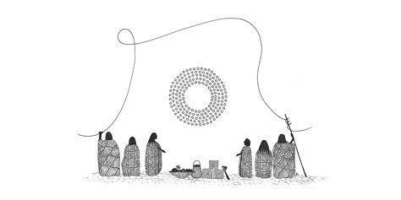
Acknowledgment of Country/Women.
We would like to acknowledge the Wurundjeri people and their land on which we gather today. We acknowledge the elders both past, present and emerging.
We also acknowledge the strong women that have resided on this land and the labour they committed into allowing for the growth of our nations. Women are strong, powerful figures within this world and we believe that they need to be recognised for their many talents and abilities that they hold.

Slide 3
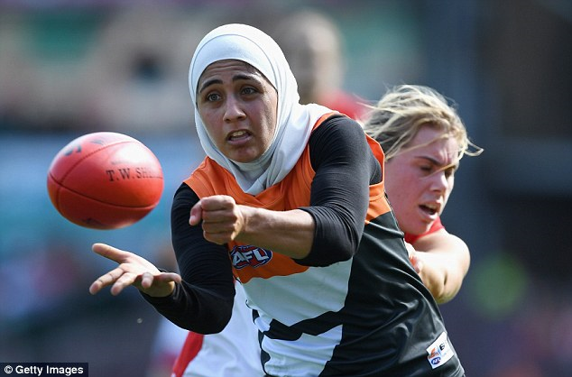
Our Vision
Increase revenue to $10million in a 4 year time period.
Increase participation in young females
Having a wider demographic support AFLW

Slide 4
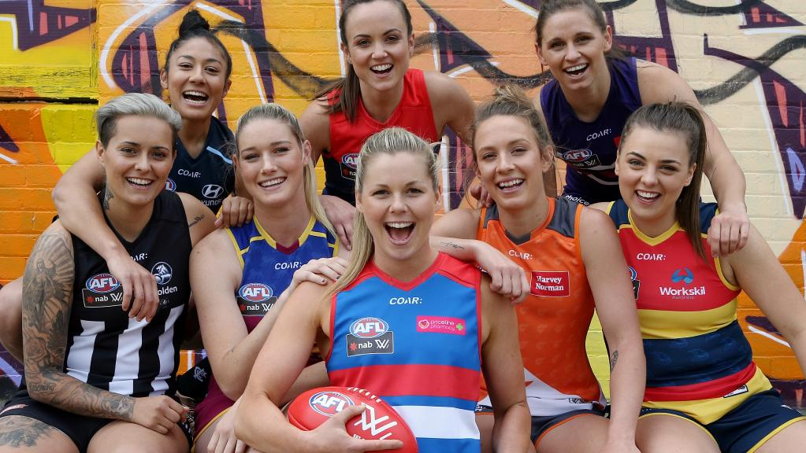
Strategies that are going to achieve this vision
Having unique and aggressive ideas that will encourage the broader society to support and invest in AFLW.
Interviews
Memberships
Broadcasting Rights
Specialty rounds
Tickets

Slide 5
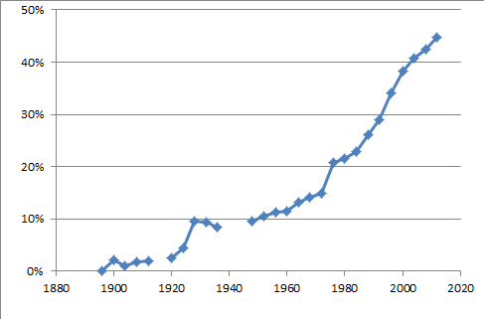
Women in Sport
Percentage of Women in the Olympics over 140 years

Slide 6
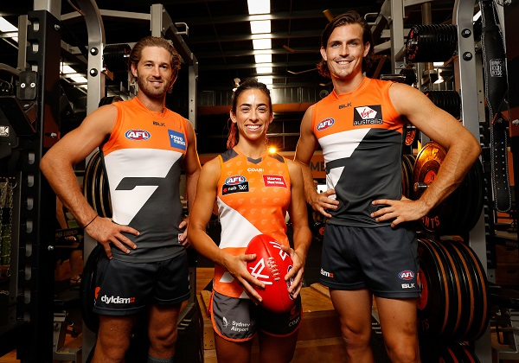
First Year Revenue Strategies
Introduce a membership system for all AFLW Clubs
Interviews with AFLW players
Meet and Greets
AFL players to promote AFLW games
Having Lorna Jane as a sponsorship

Slide 7
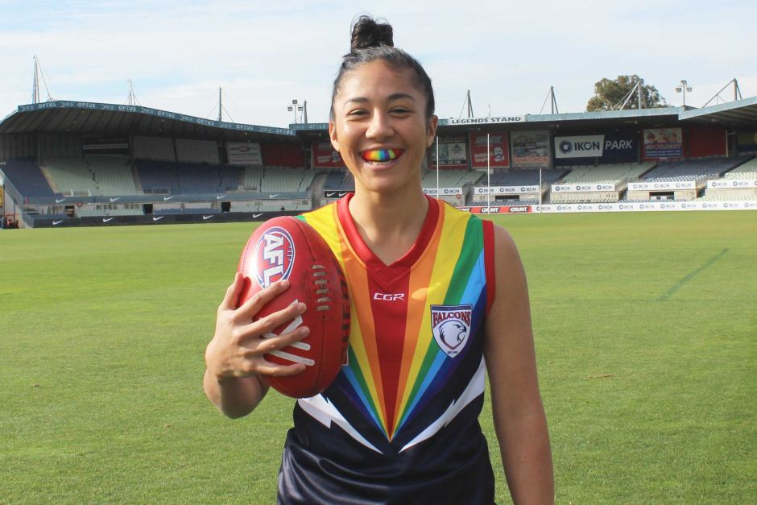
Second Year Revenue Strategies
Continue using first year strategies
Develop some forms of independence
AFLW games before AFL exhibition matches
Specialty rounds (LGBTQIA+ and Indigenous)
Jessica Mauboy to sing at the 2018 AFLW Grand Final

Slide 8
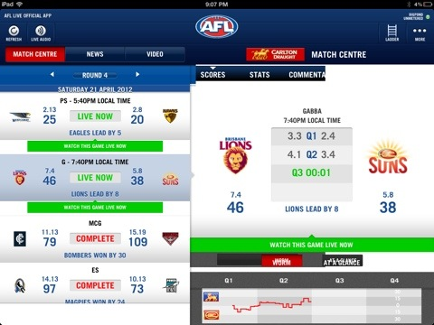
Third Year Revenue Strategies
Introduce Paid Tickets
AFLW IOS/Android App
Season passes linked with the app

Slide 9
Fourth Year Strategies
Obtain broadcasting rights
Continue to use previous strategies

Slide 10
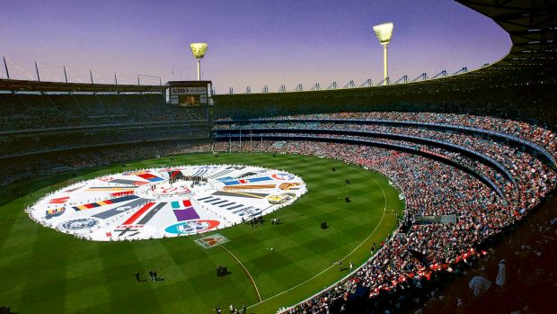
End Vision
$10million of revenue in a 4 year period
Display the talents of the female athletes all around Australia
To expand the demographic of supporters

Slide 11
THANK YOU

