Slide 1
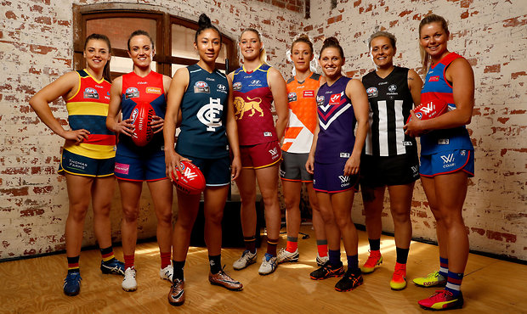
Women of the future (Raising revenue for AFLW)
Jeleena, Tegan, Chelsea and Rose

Slide 2
Current situation
Currently Australian football has been male dominated, misogynistic and in some area’s of the nation women are not supported to play professionally.
We want to create a sport that allows girls and women to participate and succeed, not only is this a major key, but there are a lot of other factors like, making a home/comfort like feeling on the grounds and in the audiences seats.

Slide 3
Problem statement
How can we raise $10 million revenue for AFLW over 5 years?

Slide 4
Issue 1
Increasing support from a wider demographic –
Strategies -
- Start getting people interested in terms and the game of AFLW
- Local teams
- Schools
- Small towns
- Merchandise (womens shirts and different logo)
- Partnership with schools with female football towns or those planning on one.)

Slide 5
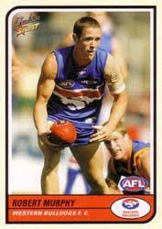
Issue 2
Hypothesis A -
- Negotiate sponsorship and broadcast deals
- Work with sponsors to negotiate deals where their product can be a sold at games
Example –
Kellogg’s Australia
- Maybe consider a specific game/ round profile?
- Card profiles in the Kellogg's cereal box. Collect 5, be in the draw to win free passes to AFLW and be in a Kellogg's add.
Selling boxes at games to increase promotion and revenue.

Slide 6
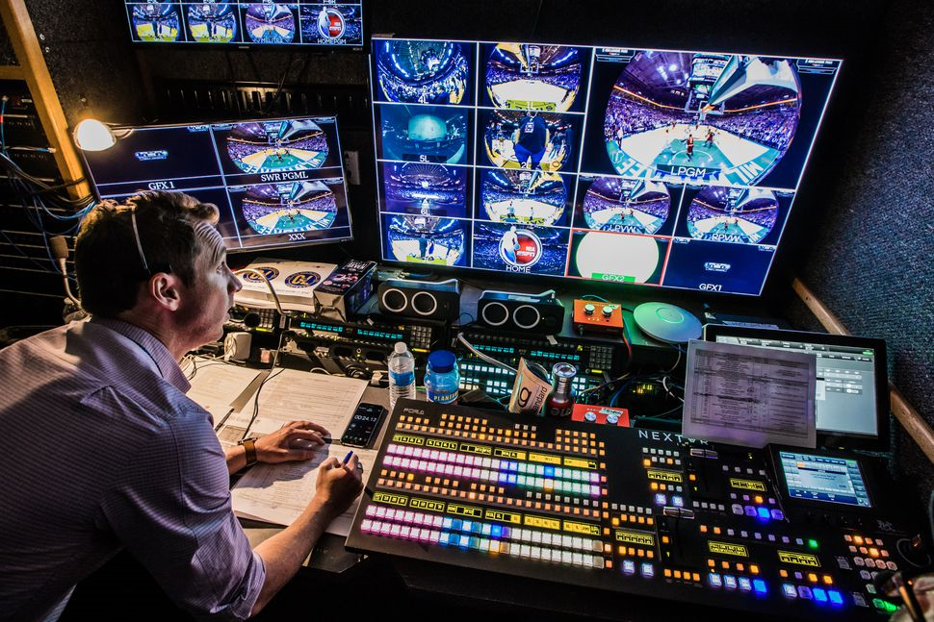
Issue 2
Hypothesis B
- Negotiate with current broadcast to increase broadcasting rights
- Currently the AFL signed $2.5 billion deal for 6 years with prime seven

Slide 7
Issue 2
Hypothesis C
- Negotiate with current betting companies
- Currently the AFL signed $50million deal with betting company
Betting -
- $55 million from beating companies for the AFL.
- INCREASING revenue.

Slide 8
Issue 3
Hypothesis D
- Increase the fee on existing membership
Example -
- current membership fee’s (increase by xx? Percentage?)
And/ or
- Create new categories of membership
Example -
- game membership
Stats -
2017 excessed 400,00 paid memberships.
Bring out different types of memberships

Slide 9
Issue 3
Hypothesis D -
- Charge an entry fee or percentage of entry for women's games
- Current attendance at AFL 6,306,336 for 2016 year
By third year, starting at 20 dollars and working our way up.

Slide 10
Thank You

